Slide 1
R Session 7
Strategies of analysis for logistic regression modelling.
How to justify and properly choose which variables to include.

Slide 2
Strategies of analysis
Where you get to distinguish yourself from the pure data scientists by approaching your modelling from a medical standpoint and using the approach which fits the research question.
Most research questions can be addressed with one of two types of models
Predictive
Causal

Slide 3
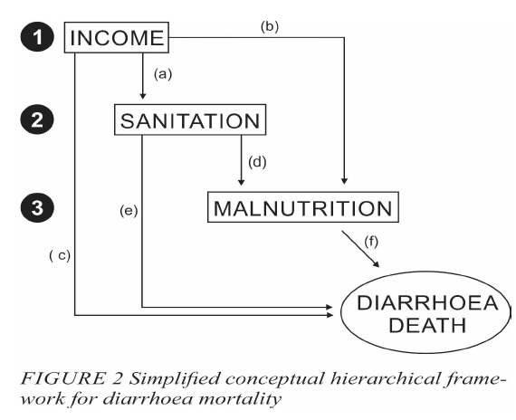
CAUSAL MODELLING
Causal modelling suitable for where there is ONE MAIN EXPOSURE of interest in the study.
And the other variables collected can be considered as potential confounders or effect modifiers
Directed Acyclic Graphs can be helpful in specifying your causal model.

Slide 4
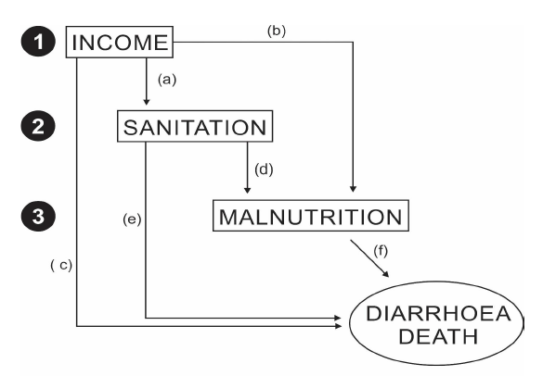

DAGs
These allow us to set down on paper what we assume the underlying causal associations to be.
Very useful to find variables NOT to control for as they are on the causal pathway between two others
If there are only a few confounders using a DAG to specify them and them add them in a model is a valid approach and no ‘strategy’ is needed
However, sometimes there are many potential confounders and because of sparse data we can’t control for them all at the same time
We then need to use a modelling strategy

Slide 5
Using regression models - caution
When using a regression based model the gain in statistical efficiency occurs because the model makes certain assumptions about the structure of the data (most importantly no interactions between confounders) – these assumptions may be wrong
Simply writing a single line glm() means you lose control and understanding of the analysis, and then it is easy to make mistakes
Always do simple stratified analysis first.
2x2 then Mantel-Haenszel and then replicate with regression

Slide 6
Criteria for Confounding
The definition for confounding is something I’ve spoken about a bit before but refers specifically to the exchangeability of the groups being compared – are the exp and non-exp groups the same with respect to their baseline disease risk?
How to choose potential confounders?
Prior knowledge (age + gender are almost always included)
This may also specify causal pathway variables
Exploratory analyses of the data

Slide 7
Confounding assessment in practice
We most commonly consider the collapsibility of the data across confounder strata by comparing the adjusted and unadjusted effect estimates – do we get the same result if we ‘collapse’ the confounder strata into a single 2x2 compared with adjusting/summarising across strata.
Then we decide whether the adjusted and unadjusted effect estimates are sufficiently different (4.5 to 2 OR would be important, whereas 4.5 to 4.3 might not be)
IT IS INVALID TO USE SIGNIFICANCE TESTING TO DECIDE WHETHER A FACTOR IS CONFOUNDER

Slide 8
Causal Modelling
The main exposure should ALWAYS be in the model
Decisions on adding potential confounders should be based on whether the main exposure effect changes
There is no need to include interaction terms in the initial analyses
THEREFORE
All potential confounders should be controlled if possible (there is little benefit to a simpler model if it’s stable)

Slide 9
Causal Modelling
However, adding in variables which are strongly correlated with another exposure will result in multicollinearity and make the model unstable. This happens because it is difficult to separate their individual effects in the model and it increases the root mean square error.
In addition if there are too many variables in the model there can be problems from sparse data (remember rule of 10 – number of events/cases should be roughly 10 times the number of parameters)

Slide 10
Sparse Data
Only conditional likelihood (hypergeometric method used in MATCHED CASE CONTROL STUDIES) and Mantel-Haenszel (weighted low covariate model) methods remain approximately valid in sparse data.
However, the rule of 10 continues to apply but it relates there to numbers of discordant case-control pairs rather than the numbers of cases and controls
Moving forward we will assume there are no problems with sparse data.

Slide 11
Add/Deleting Variables
Need to:
Control confounding
Avoid multicollinearity
Effect measure modification is of a much lesser concern unless you have a strong medical suspicion to examine it.
If you do assess effect modification, only do it at the end once you’ve settled on a ‘final model’

Slide 12
2 Approaches To Modelling
BACKWARDS
Run the ‘full’ model including all potential confounders, and then only run a reduced model if there are problems of multicollinearity
FORWARDS
The model is first run with only the main exposure and our pre-defined a priori variables, and then the potential confounders are added one at a time, retaining the variables which change the main effect estimate by ‘an important amount’ – defined by the user.

Slide 13
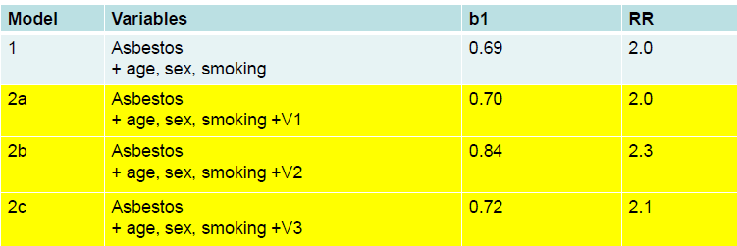
Forward Approach
Outcome = Lung Cancer (b1 is the coefficient of Asbestos)
Which confounder to keep?

Slide 14
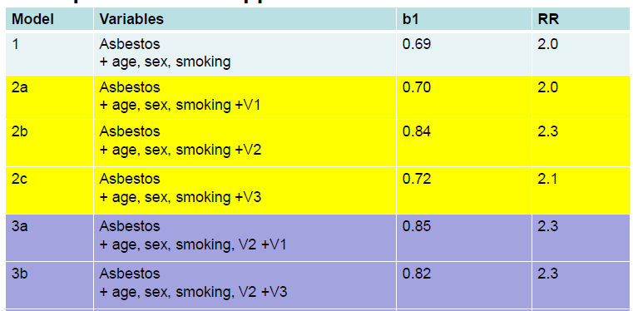

Second Round

Slide 15
Taking into account Mean-squared Error
There are at least two sources of error when a regression analysis is preformed
Random error
Bias due to uncontrolled confounding
Random error can be estimated using the SE of the regression coefficient.
Minimising standard error change in the exposure coefficient is important.

Slide 16
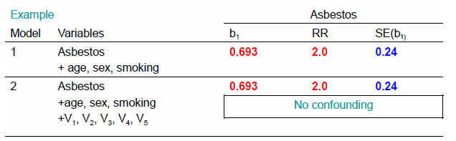
Scenarios

Slide 17
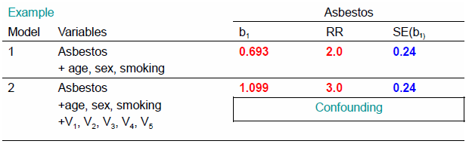
Confounding

Slide 18
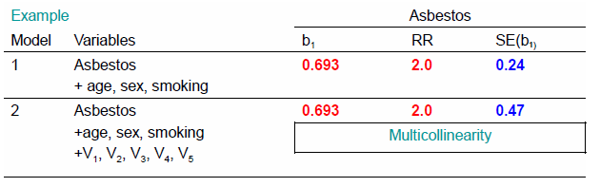
Multicollinearity

Slide 19
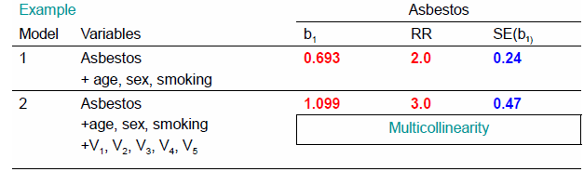
Both
Try to find a ‘reduced’ model which still controls for confounding (not changing the RR), but also avoids multicollinearity by removing V1,2,3,4,5 one at time
If that doesn’t work, keep the full model or consider ML methods

Slide 20
Minimising RMSE
The MSE is based on two components
The error in the coefficient, compared to the coefficient in the ‘full’ model
(beta model – beta full)^2
And random error (SE squared)
Observe what the RMSE for the models are when you include univariate analyses and multivariate analyses and see whether the inclusion of certain variables increases or decreases it.

Slide 21
Practice with ‘real world data’
Import the Uganda_first_lrti dataset from the google drive
Examine the data
This was initially set up to be a cohort longitudinal modelling exercise, however Poisson and Cox regression are beyond the scope of Gatenby’s brief and are simple enough to explore yourself using what we’ve learned already.
The outcome is ever developing a LRTI, and the exposure is maternal malarial infection.

Slide 22
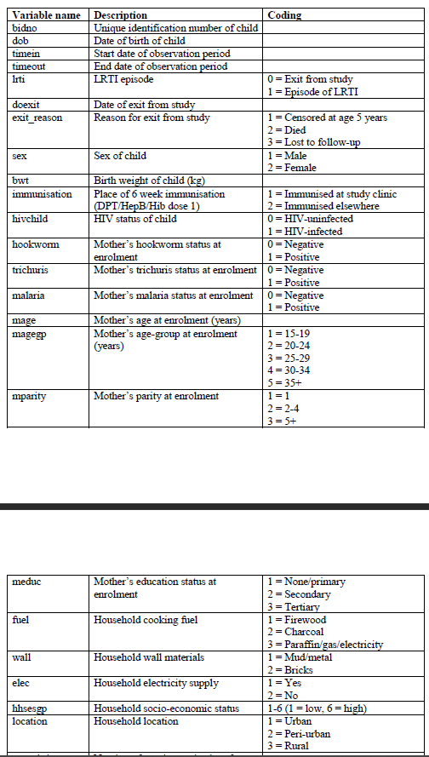
Here’s the codebook

Slide 23
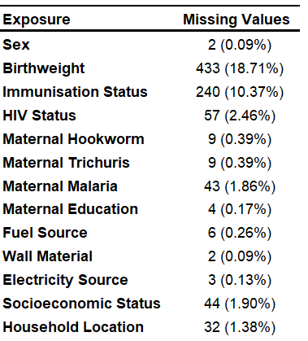
An approach
Define a priori variables
Maternal age
Infant gender
Household socioeconomic status (1-6) <- be careful about multicollinearity
Run analyses of each of the potential confounders, and lrtest them with the base a priori model. This gives you a short list of what are actually confounders.
Make sure that if there is no significant change in effect, then that the RMSE doesn’t rise by adding in a new variable.
Chuck them all in a model and see if the RMSE rises too much, if it does then you have to make a judgement call to remove a variable with a high RMSE change but small effect change. If you can’t do this then accept defeat. This is where personal opinion comes into modelling.

Slide 24
Introduction to lapply
Applies complex functions to a vector, returning a list
You can make your own function to use in lapply as well
lapply returns a list of the same length as X, each element of which is the result of applying FUN to the corresponding element of X.

Slide 25
A note about lrtest
The nested model has to have the same number of degrees of freedom as the complex model
What this means in practice is you need to subset the original a priori model without NA values of the variable you’re testing
This code can do that
subset_dataset <- dataset[complete.cases(dataset[,variable),]
Then model with that dataset
Then lrtest(subset_model, var_model)

Slide 26
Homework and final assessment
Create a model to adequately explain the relationship between lrti and maternal malaria infection.
Examine multicollinearity
Justify your modelling strategy
Send me your code including the final glm() with annotations
Or don’t, I’m not your consultant.

